Slide 1
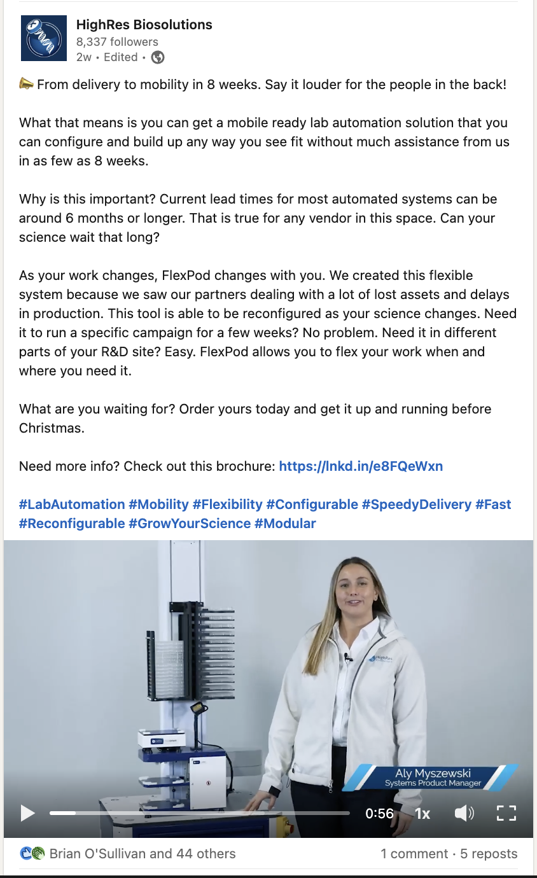

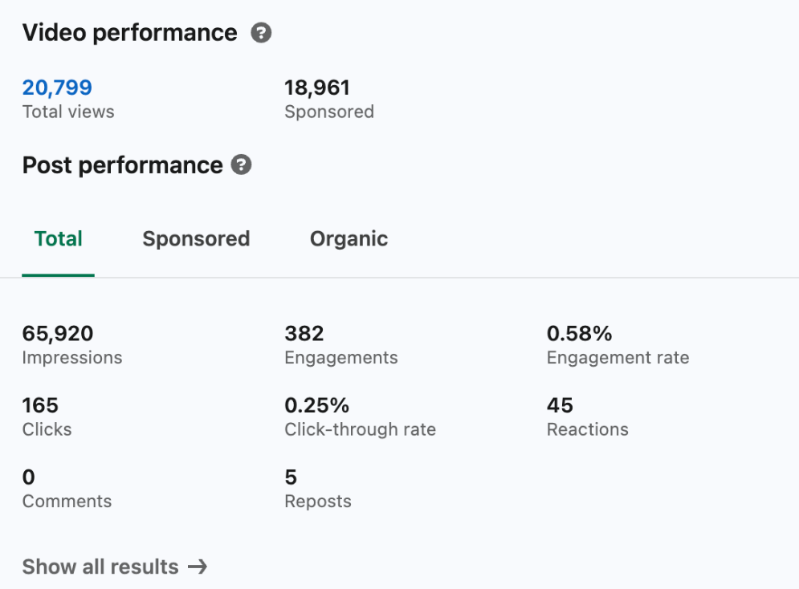
HighRes Biosolutions: Boosted Posts
Client Need
HighRes Biosolutions, a technology leader in lab automation, partners with Affirma for their ongoing marketing needs. Organic social is a crucial tactic in the overall demand and lead gen strategy.
The team has begun to incorporate boosted social posts, turning a well-performing post into a paid ad to promote to a wider audience and target specific demographics to increase its reach and engagement.
Typical impressions for unboosted posts are in the 1-5K range.
Once boosted, posts are reaching over 65K impressions.

